Slide 1

INFO 307 MODELISATION DES SYSTEMES D’INFORMATION
OLLE OLLE
Département d’Informatique
Faculté des Sciences –Université de Yaoundé I

Slide 2
Notes Importantes
Description
Recall on the fundamentals of IS
Typology and Specificities of Information System Engineering
Business Process Modeling and Notation (BPMN)
Object Oriented Modeling
Unified Modeling Language (UML)
System Design and Analysis
Case Study

Slide 3
Objectifs du Cours
A la fin des enseignements l’étudiant devra etre capable de:
Classifier les différents types de SI
Comparer les différents modèles de cycles de développement
Expliquer le processus de développement de SI
De dialoguer avec des équipes SI
Appliquer les principes d’analyse et de conception de SI
Distinguer les particularités des différentes approches de modélisation

Slide 4
Objectifs du cours (suite)
Appliquer les méthodologies d’analyse et de développement des SI
Utiliser des outils de modélisation dans un projet SI
Évaluer les méthodologies d’analyse et de développement des SI
Evaluer la pertinence des solutions

Slide 5
INTRODUCTION

Slide 6
Important definitions (in French)
Modèle: est une représentation abstraite d’un phénomène en utilisant un formalisme spécial.
Méthode de modélisation: c’est la façon de décrire comment modéliser et construire un modèle en utilisant des éléments de modélisation, une représentation graphique, du savoir-faire et des règles;
Cahier des charges: c’est un document qui vise à définir les spécifications de base d’un produit ou d’un service à réaliser.

Slide 7
Module 1- RECALL ON DEFINITIONS AND FUNDAMENTALS OF INFORMATION SYSTEMS

Slide 8
What is an Information System?
An organized combination of people, hardware, software, communications networks, and data resources that collects data, transforms it, and disseminates information.
Example:
Registration system
Online order system
Online banking system

Slide 9
Data Vs. Information
Data: Raw unorganized facts
Information:
A collection of facts organized in such a way that they have additional value beyond the value of the facts themselves.
Data organized in a meaningful way for the user (in consideration of the environment)

Slide 10
Data → Information
Data
Transformation
Information

Slide 11
Information Concepts
Process:
A set of logically related tasks performed to achieve a defined outcome.
Knowledge:
An awareness and understanding of a set of information and ways that information can be made useful to support a specific task or reach a decision

Slide 12
The Value of Information
The value of Information
is directly linked to how
it helps decision makers
achieve their organization’s
goals.

Slide 13
System
A system is a set of elements or components that interact to accomplish goals.

Slide 14
CBIS
Hardware:
Computer Equipment
Software:
Computer Programs
Databases:
An organized collections of facts

Slide 15
CBIS
Telecommunications:
Electronic transmission of signals for communication
Networks: Distant electronic communication
Internet: Interconnected Networks
Intranet: Internal Corporate Network
Extranet: Linked Intranets

Slide 16
CBIS
People
Procedures:
Strategies, policies, methods, and rules for using a CBIS.

Slide 17
II-Business Information Systems

Slide 18
Electronic and Mobile Commerce
E-Commerce:
Any business transaction executed electronically
M-Commerce:
Business transactions conducted anywhere, anytime, using mobile device
Relies on wireless communications

Slide 19
TPS and ERP
Transaction
business related exchange
Evidence of a business event
Transaction Processing System (TPS)
A system which records completed business transactions
Enterprise Resource Planning (ERP)
A set of integrated programs for managing the entire business operations

Slide 20
Business Information Systems
Management Information System:
A system used to provide routine information to managers and decision makers
Decision Support System:
A system used to support problem specific decision making

Slide 21
Expert System:
A system that gives a computer the ability to make suggestions and act like an expert in a particular field.
Knowledge Base: The collection of data, rules, procedures, and relationships that must be followed to achieve value or the proper outcome.

Slide 22
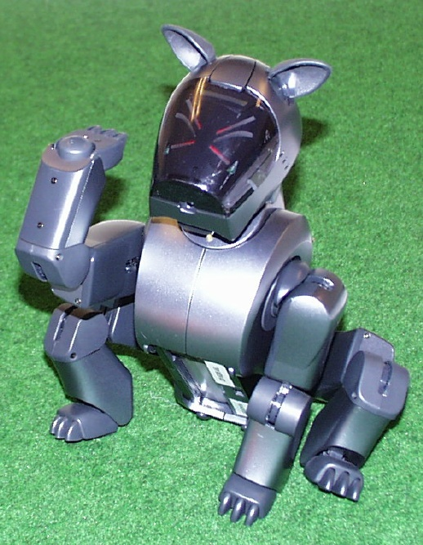
Specialized Business I.S.
Artificial Intelligence (AI):
A field in which the computer takes on the characteristics of human intelligence

Slide 23
Information System Activities
Input of Data Resources
Process Data into Information
Output of Information

Slide 24
Process Data into Information
Calculate
Compare
Sort
Classify
Summarize
The quality of the data must be maintained by a continual process of correcting and updating activities

Slide 25
Input of Data Resources
Data entry
Editing
Machine readable
Source documents
Formal record of a transaction
User interface
How users interact with information system
Optical scanning; menu; prompts; fill in blanks

Slide 26
Output of Information
Transmit information to users
Display; paper; audio
Storage of data
Data are retained in an organized manner
Fields; records; files; data bases
Control of system performance
Feedback must be monitored and evaluated to determine if the information system is meeting established performance standards

Slide 27
Environment:
Business - other functional areas
Computer – hardware, software, other IS
Sub System:
Component of a larger system
System Boundary:
Interaction with environment (user or other system) via an interface

Slide 28
General Information Systems Diagram
Management Decisions
(Environment)
Data
Input
Process
Output
Information
Control
Feedback

Slide 29
Systems Applications in the Organization
Decisions
Management Levels
Information Systems
Unstructured
Senior Management
ESS
Strategic
DSS
Knowledge and Data Worker
Tactical
Middle
Management
MIS
Lower
Management
TPS
Technical
(Operational)
Buy
Make
Sell
Keep
Track
Functions
Structured

Slide 30
Next…

Slide 31
Module 2- Systems Modeling and Development

Slide 32
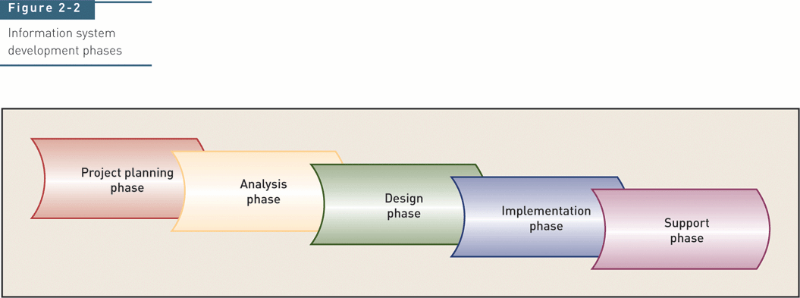
Traditional System Development Life Cycle (SDLC)

Slide 33
System Modeling:
The activity of representing a system in order to grasp its overall complexity for the design process.
System Development:
The activity of creating or modifying existing business information systems

Slide 34
Test Yoursel
In order to best support user’s IT needs, IT professionals need to understand the company’s business operations. What process might a system analyst use to accomplish this?
Notes:
49

Slide 35
Test Yourself
In order to best support user’s IT needs, IT professionals need to understand the company’s business operations. What process might a system analyst use to accomplish this?
Business process modeling is used to represent a company’s operations and information needs
Notes:
49

Slide 36
Test Yourself
What are the five key components of information systems?
Notes:
49

Slide 37
Test Yourself
What are the five key components of information systems?
Hardware
Software
Data
Processes
People
Notes:
49

Slide 38
Test Yourself
How are business information systems identified?
Notes:
49

Slide 39
Test Yourself
How are business information systems identified?
Functions and features
Notes:
49

Slide 40
Test Yourself
T/F: An enterprise computing system is highly specialized and targeted for a company’s top executives.
Notes:
49

Slide 41
Test Yourself
T/F: An enterprise computing system is highly specialized and targeted for a company’s top executives.
False. Enterprise computing systems support company-wide data management requirements
Notes:
49

Slide 42
Test Yourself
Top management is typically responsible for ________ planning, while middle management focuses on __________ planning.
Notes:
49

Slide 43
Test Yourself
Top management is typically responsible for strategic planning, while middle management focuses on tactical planning.
Notes:
49

Slide 44
Test Yourself
CASE tools are:
a) an object oriented methodology
b) techniques or tools to help plan and design information systems
c) team-based fact finding techniques
Notes:
49

Slide 45
Test Yourself
CASE tools are:
a) an object oriented methodology
b) techniques or tools to help plan and design information systems
c) team-based fact finding techniques
Notes:
49

Slide 46
Test Yourself
Objects, classes, and methods are all terms used in structured/object oriented methodologies
Notes:
49

Slide 47
Test Yourself
Objects, classes, and methods are all terms used in structured/ object oriented methodologies
Notes:
49

Slide 48
Test Yourself
What are the phases of the systems development life cycle?
Notes:
49

Slide 49
Test Yourself
What are the phases of the systems development life cycle?
Systems planning
Systems analysis
Systems design
Systems implementation
Systems operation and support
Notes:
49

Slide 50
Test Yourself
List at least three of the six functions of a typical IT department
Notes:
49

Slide 51
Test Yourself
List at least three of the six functions of a typical IT department
Application development
Systems support
User support
Database administration
Network administration
Web support
Notes:
49

Slide 52
Test Yourself
T/F Certification is a professional credential that is valued by little (if any) companies.
Notes:
49

Slide 53
Test Yourself
T/F Certification is a professional credential that is valued by little (if any) companies.
False
Notes:
49

